Slide 1

Computer Networks
王廷
华东师范大学 软件工程学院 Email: twang@sei.ecnu.edu.cn
Office: 理科大楼B1116室

Slide 2
Chapter 4：Medium Access Control Sublayer
Channel Allocation Problem
Multiple Access Protocols
Ethernet
Wireless LANs
Broadband Wireless
Bluetooth
RFID
Data Link Layer Switching

Slide 3
The MAC Sublayer
Responsible for deciding who sends next on a multi-access link
An important part of the link layer, especially for LANs
Application
Transport
Network
Link
Physical
MAC is in here!

Slide 4
Multiple Access Problem
An example: a classroom
Human protocols:
“Give everyone a chance to speak”
“Don’t speak until you are spoken to”
“Don’t monopolize the conversation”
“Raise your hand if you have a question”
“Don’t interrupt when someone is speaking”
“Don’t fall asleep when someone else is talking”
In LANs, WiFi, satellite networks, cocktail party,
If more than 2 users send at the same time - collision
All collided packets are lost -> waste of bandwidth

Slide 5
Channel Allocation Problem
For fixed channel and traffic from N users
Divide up bandwidth using FDM, TDM, CDMA, etc.
This is a static allocation, e.g., FM radio
This static allocation performs poorly for bursty traffic
Allocation to a user will sometimes go unused
Dynamic allocation gives the channel to a user when they need it.
Potentially N times as efficient for N users.
Notes:
FM Radio调频无线广播的频率是80到108MHZ

Slide 6
Assumptions for Dynamic Channel Allocation
Dynamic allocation gives the channel to a user when they need it.
Schemes vary with assumptions:
信道分配模型的五个基本假设
Assumption | Implication
Independent traffic 流量独立 | Often not a good model, but permits analysis
Single channel 单信道 | No external way to coordinate senders
Observable collisions 冲突可观察 | Needed for reliability; mechanisms vary
Continuous or slotted time 时间连续或时间分时隙 | Slotting may improve performance
Carrier sense 载波监听 | Can improve performance if available
确定何时发送
确定能否发送

Slide 7
Chapter 4：Medium Access Control Sublayer
Channel Allocation Problem
Multiple Access Protocols
Ethernet
Wireless LANs
Broadband Wireless
Bluetooth
RFID
Data Link Layer Switching

Slide 8
Multiple Access Protocols
ALOHA »
CSMA (Carrier Sense Multiple Access) » 载波监听多路访问
Collision-free protocols » 无冲突协议
Limited-contention protocols » 有限竞争协议
Wireless LAN protocols »

Slide 9
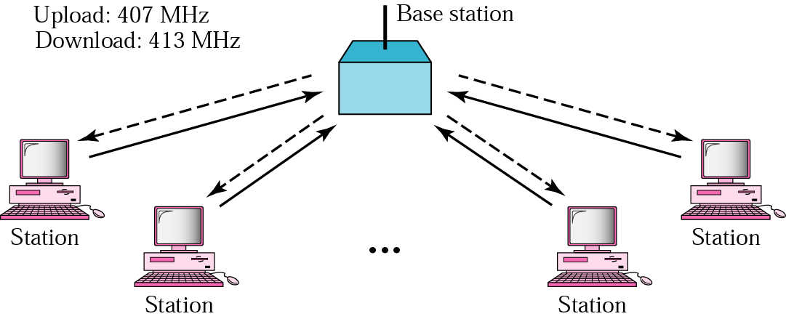
ALOHA Network
ALOHA-NET is developed by Norm Abramson at the Univ. of Hawaii
the guy had interest in surfing and packet switching
mountainous islands → land-based network difficult to install
fully decentralized protocol
最早采用争用协议的网络
两个版本：Pure ALOHA，Slotted ALOHA
ACK
ACK
ACK
ACK

Slide 10
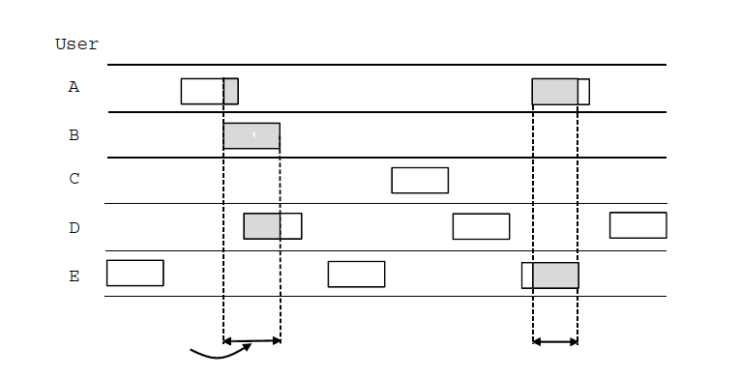
Pure ALOHA
In pure ALOHA, users transmit frames whenever they have data; users retry after a random time for collisions
每个站点只要有数据就可发送；通过信号反馈和检测信道来发现是否发送冲突；若冲突则等待一段随机时间，再重新发送
Efficient and low-delay under low load
User
A
B
C
D
E
一旦两帧同时试图占用信道，就会发生冲突，两帧都被损坏。
注意：纯ALOHA中站在传输之前不侦听信道
注意：即使少量重叠，两帧也彻底破坏
Collision
Collision
Time
纯ALOHA特点：想发就发

Slide 11
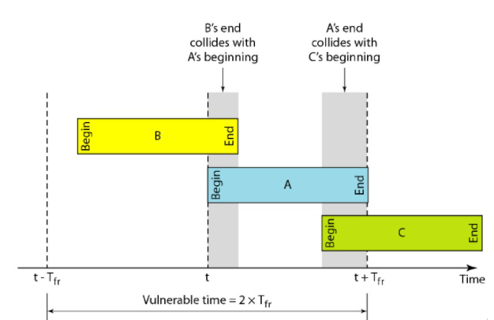
Vulnerable Period
Collisions happen when other users transmit during a vulnerable period that is twice the frame time
Synchronizing senders to slots can reduce collisions
Frame time（帧时）: the frame length divided by the bit rate传输一个标准的，固定长度的帧所需要的时间（即帧长除以比特率）
Notes:
Vulnerable Period易损期、脆弱期

Slide 12
Example
A pure ALOHA network transmits 200-bit frames on a shared channel of 200 kbps.
What is the requirement to make this frame collision-free?
Solution
Frame time is 200 bits/200 kbps or 1 ms.
The vulnerable time is 2 × 1 ms = 2 ms.
This means no station should send later than 1 ms before this station starts transmission and no station should start sending during the period (1ms) that this station is sending.

Slide 13
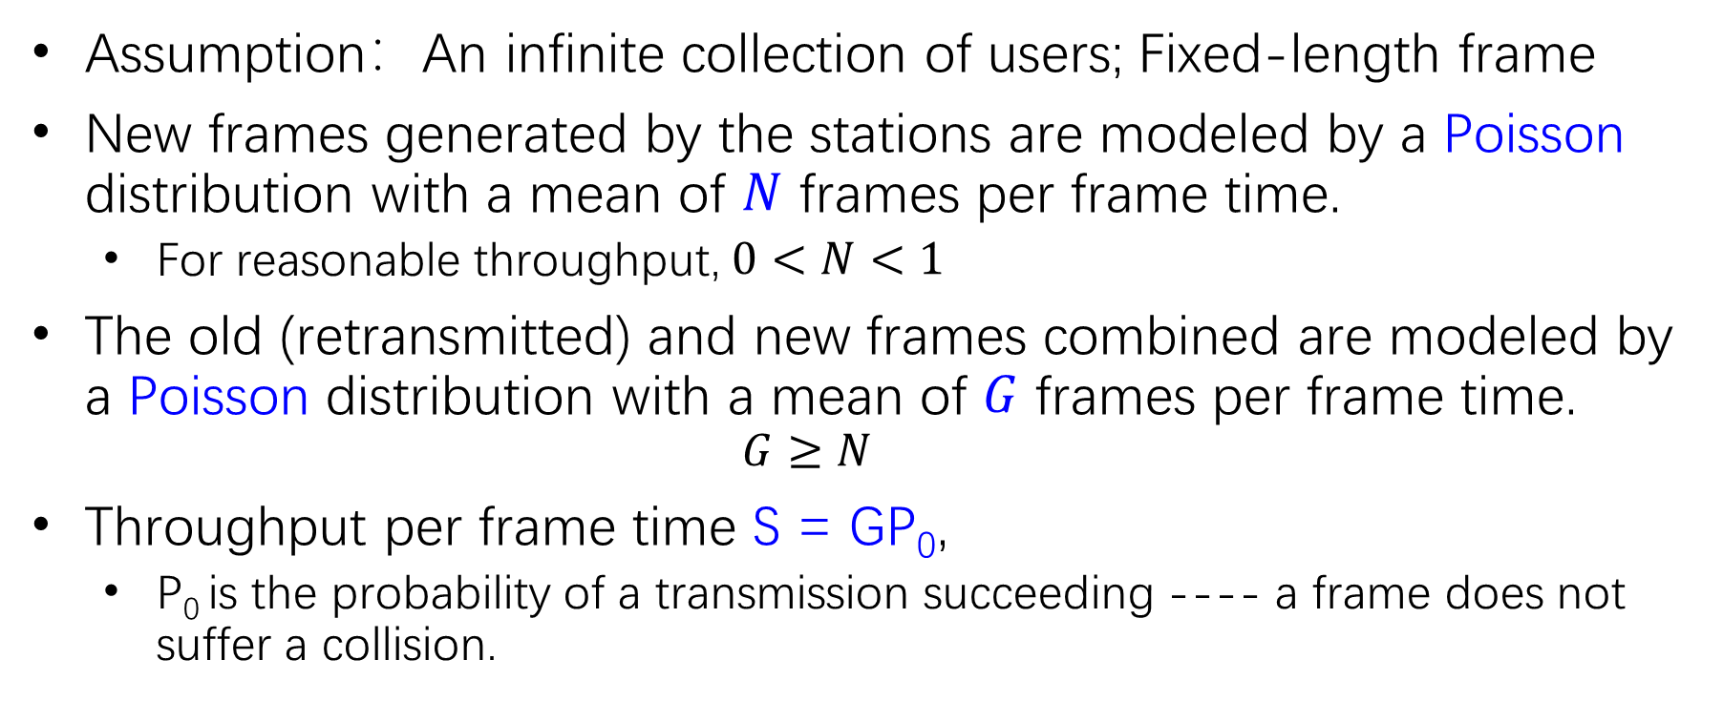
Channel Utilization (1)
Assumption：An infinite collection of users; Fixed-length frame
New frames generated by the stations are modeled by a Poisson distribution with a mean of $N$ frames per frame time.
For reasonable throughput, $0<N<1$
The old (retransmitted) and new frames combined are modeled by a Poisson distribution with a mean of $G$ frames per frame time.
$$G≥N$$
Throughput per frame time S = GP₀,
P₀ is the probability of a transmission succeeding ---- a frame does not suffer a collision.

Slide 14
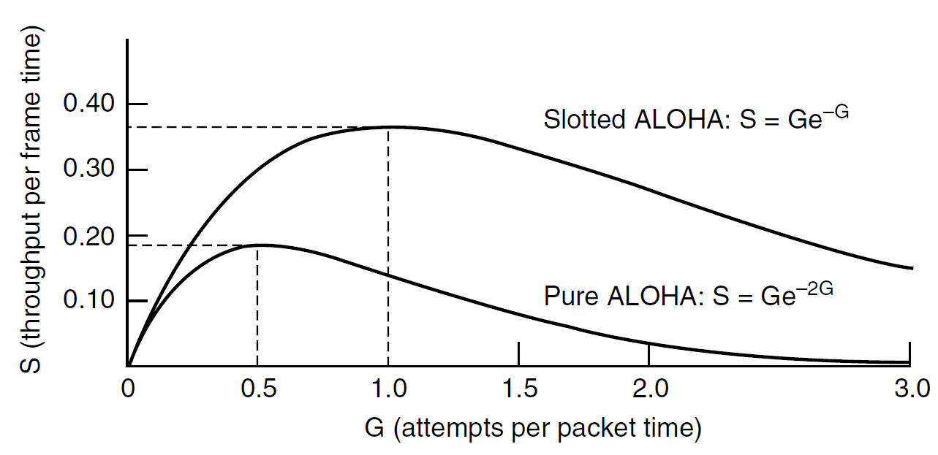
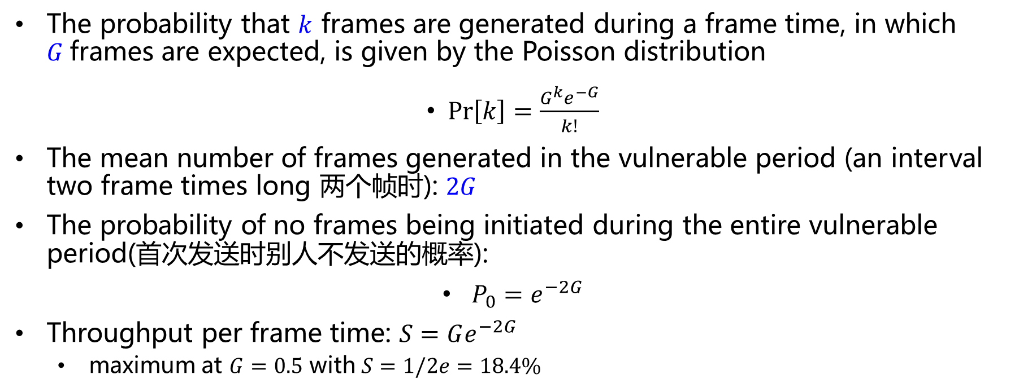
Channel Utilization (2)
The probability that $k$ frames are generated during a frame time, in which $G$frames are expected, is given by the Poisson distribution
$\operatorname{Pr}\left[k\right]=\frac{G^{k}e^{−G}}{k!}$
The mean number of frames generated in the vulnerable period (an interval two frame times long 两个帧时): $2G$
The probability of no frames being initiated during the entire vulnerable period(首次发送时别人不发送的概率):
$P_{0}=e^{−2G}$
Throughput per frame time: $S=Ge^{−2G}$
maximum at $G=0.5$ with $S=1/2e=18.4\%$

Slide 15
Example
A pure ALOHA network transmits 200-bit frames on a shared channel of 200 kbps.
What is the throughput if the system (all stations together) produces
a. 1000 frames per second?
b. 500 frames per second?
c. 250 frames per second?

Slide 16
Solution
The frame time is 200 bits/200 kbps or 1 ms.
a. If the system creates 1000 frames per second, or 1 frame per millisecond, then G = 1. In this case S = G × e^{−2G} = 0.135 (13.5%). This means that the throughput is 1000 × 0.135 = 135 frames. Only 135 frames out of 1000 will probably survive.
b. If the system creates 500 frames per second, or 1/2 frames per millisecond, then G = 1/2. In this case S = G × e^{−2G} = 0.184 (18.4%). This means that the throughput is 500 × 0.184 = 92. Only 92 frames out of 500 will probably survive.
c. If the system creates 250 frames per second, or 1/4 frames per millisecond, then G = 1/4. In this case S = G× e^{−2G} = 0.152 (15.2%). This means that the throughput is 250 × 0.152 = 38. Only 38 frames out of 250 will probably survive
Notes:
E -2: 0.135
E -1: 0.368
E -1/2: 0.607

Slide 17
Slotted ALOHA
Slotted ALOHA：将信道时间分为离散的时间片，每个时间片可以用来发送一个帧。一个站点有数据发送时，必须等到下个时间片的开始才能发送。与纯ALOHA相比信道的利用率提高一倍。
Requires sync of clocks
Still poor at high-loads
Vulnerable period only at one slot time
P₀=e^{-G} ,S=Ge^{-G}
When G = 1 , S=1/e, the maximum throughput

Slide 18
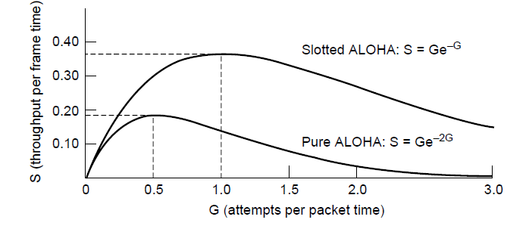
Slotted ALOHA VS Pure ALOHA
Slotted ALOHA is twice as efficient as pure ALOHA
Low load wastes slots, high loads causes collisions
Efficiency up to 1/e (37%) for random traffic models
Applied in Internet access over cable, multiple RFID tags talk to the same RFID reader

Slide 19
ALOHA Exercise
Example:
Measurement of a slotted ALOHA channel with an infinite number of users show that 20 percent of slots are idle .
What is the channel load, G?
What is the throughput?
Is the channel underloaded or overloaded?
a) Poisson distribution: P_{r}[k] = G^{k}e^{-G}/k!
P₀=e^{-G} ，so G= -lnP₀ = -ln 0.2 = 1.6
b) S = G*e^{-G} = G*0.2 = 1.6*0.2 = 0.32
c) G = 1.6 >1, so the channel is overloaded.

Slide 20
Multiple Access Protocols
ALOHA »
CSMA (Carrier Sense Multiple Access) » 载波监听多路访问
Collision-free protocols » 无冲突协议
Limited-contention protocols » 有限竞争协议
Wireless LAN protocols »

Slide 21
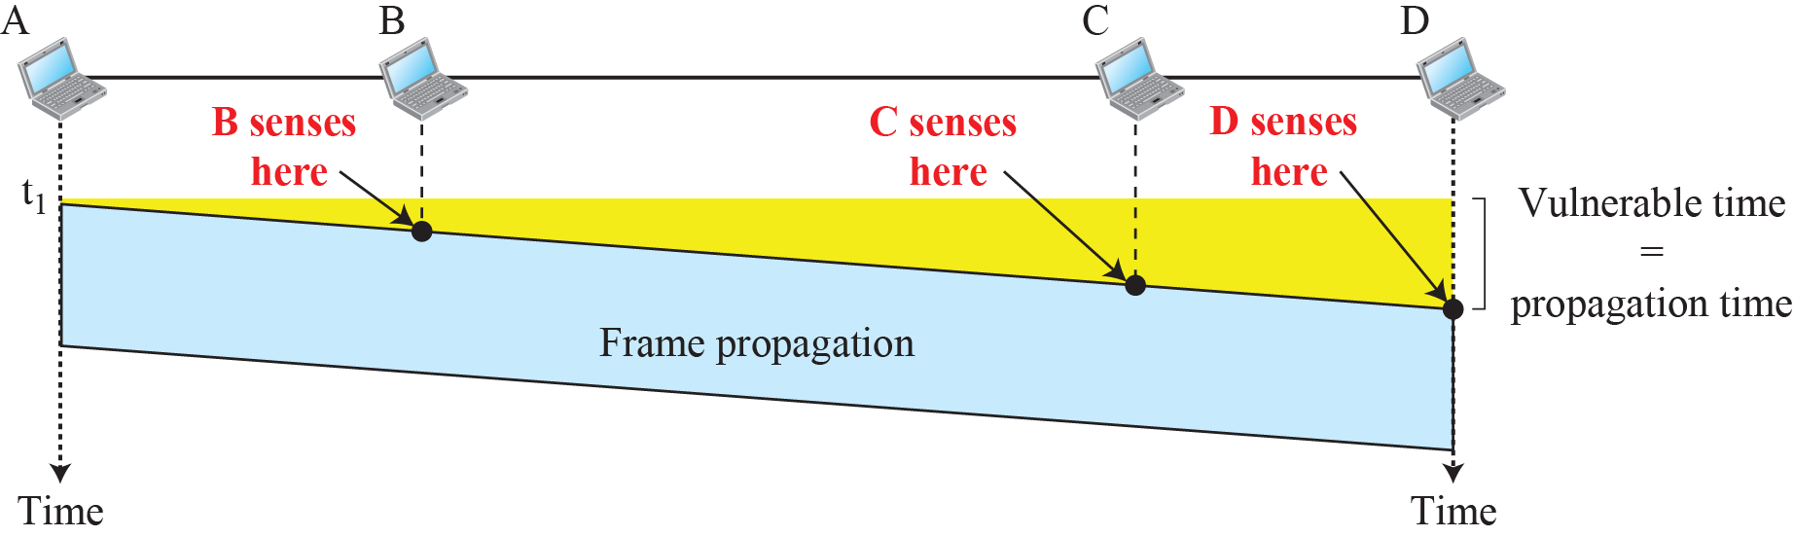
CSMA (1)
CSMA (Carrier Sense Multiple Access) improves on ALOHA by sensing the channel!
User doesn’t send if it senses someone else
Based on the principle “sense before transmit” or “listen before talk.”
CSMA特点：先听后发
Notes:
802.11 uses a refinement of p-persistent CSMA

Slide 22
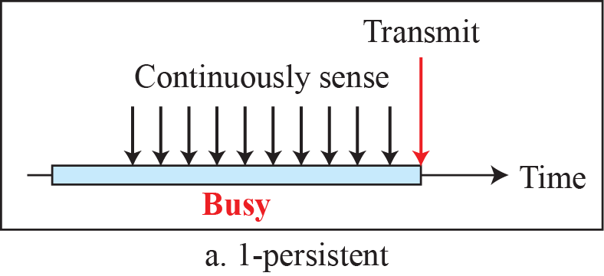
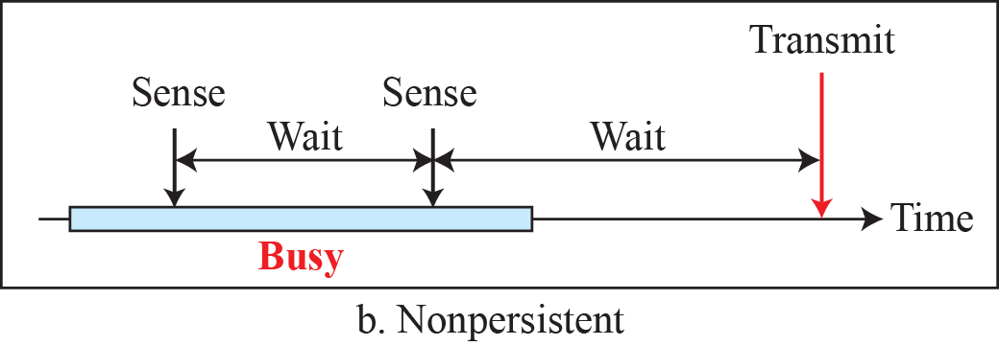
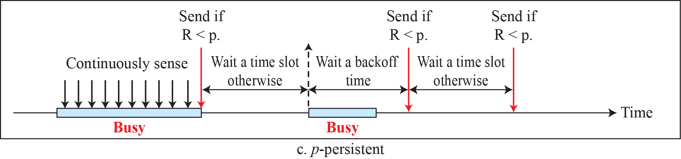
Behavior of three persistence methods
Variations on what to do if the channel is busy:
1-persistent (greedy) sends as soon as idle
Nonpersistent waits a random time then tries again
p-persistent sends with probability p when idle

Slide 23
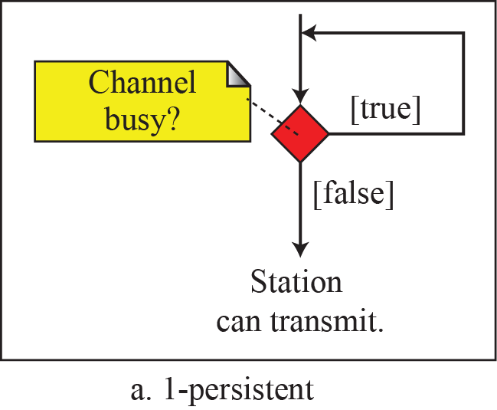
1-persistent CSMA
When a station has data to send, it first listens to the channel to see if anyone else is transmitting at that moment. If the channel is idle, the stations sends its data. Otherwise, if the channel is busy, the station just waits until it becomes idle. Then the station transmits a frame.
If a collision occurs, the station waits a random amount of time and starts all over again. 两种发生冲突的可能：
信号传输的延迟造成的冲突；比如，由于时延第一个站的信号还没到达第二个站，第二个站则会认为信道空闲，会立即发送数据；
多个站点在监听到信道空闲时，同时发送。
The protocol is called 1-persistent because the station transmits with a probability of 1 when it finds the channel idle.
此协议的性能高于ALOHA协议

Slide 24
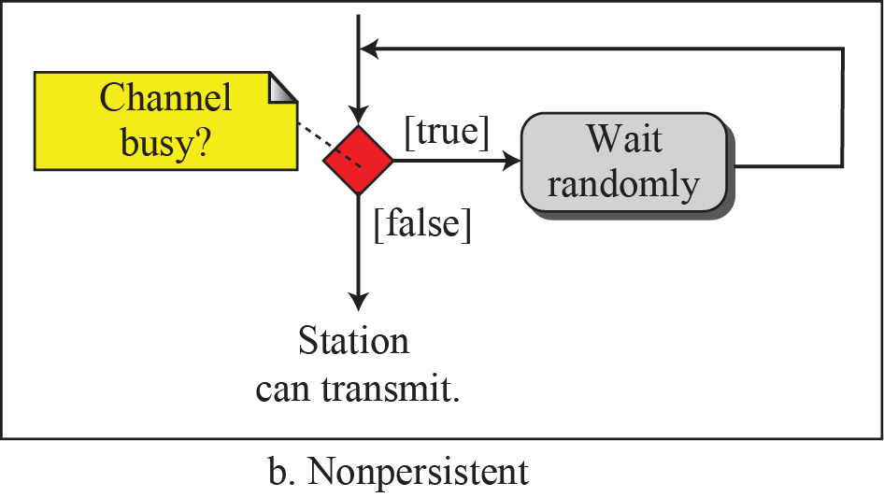
nonpersistent CSMA
As before, a station senses the channel when it wants to send a frame, and if no one else is sending, the station begins doing so itself.
However, if the channel is already in use, the station does not continually sense it. Instead, it waits a random period of time and then repeats the algorithm.
Consequently, this algorithm leads to better channel utilization but longer delays than 1-persistent CSMA.

Slide 25
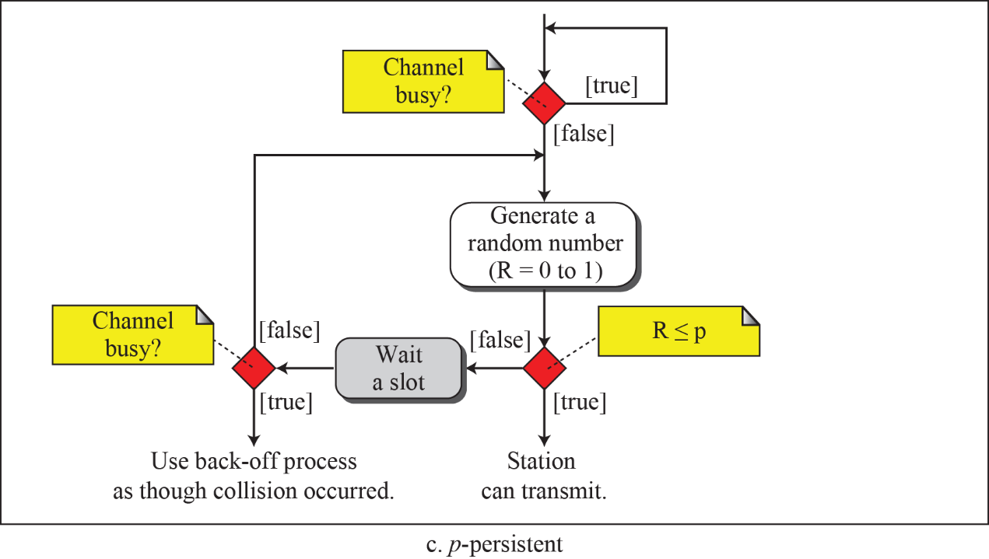
p-persistent CSMA
It applies to slotted channels.
When a station becomes ready to send, it senses the channel. If it is idle, it transmits with a probability p. With a probability q = 1 − p, it defers until the next slot. If that slot is also idle, it either transmits or defers again, with probabilities p and q. This process is repeated until either the frame has been transmitted or another station has begun transmitting.
IEEE 802.11 uses a refinement of p-persistent CSMA
概率p的目的就是试图降低1-persistent CSMA中多个站点同时发送而造成冲突的概率
采用坚持监听是试图克服non-persistent CSMA中造成的时间延迟
P的选择直接关系到协议的性能

Slide 26

Flow diagram for three persistence methods

Slide 27
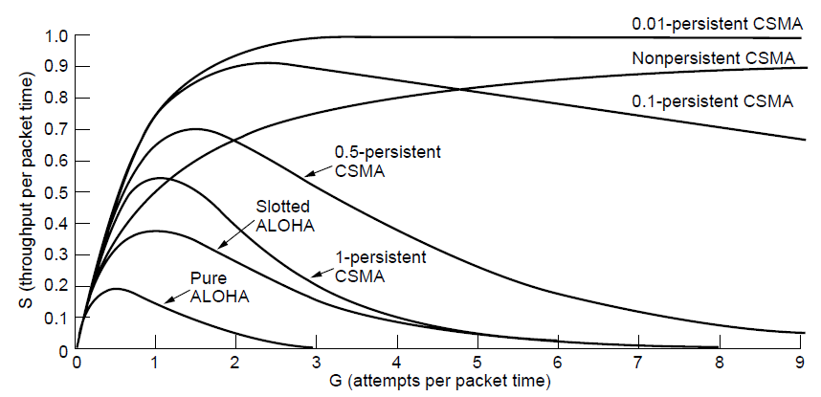
Performance of CSMA
CSMA outperforms ALOHA, and being less persistent is better under high load

Slide 28
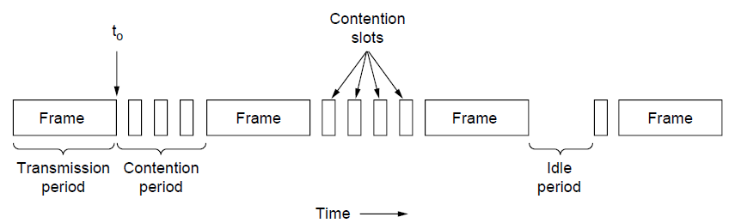
CSMA with Collision Detection (CSMA/CD)
Persistent and nonpersistent CSMA protocols are definitely an improvement over ALOHA. However, if two stations sense the channel to be idle and begin transmitting simultaneously, their signals will still collide. 而且采用“先听后发”机制，在发送过程中如果发生冲突，仍要将剩余的无效数据发送完，既浪费了时间又浪费了带宽。
CSMA/CD又做了进一步的改进，采用“先听后发”+“边听边发” 。发送过程中，仍然监听信道，通过检测回复信号的能量或者脉冲宽度并将之与发送的信号做比较，如果信号不同，就可以判断发生冲突。一旦发生冲突，立即取消发送数据，等待一随机时间后再重新尝试发送。
当发生冲突，取消发送数据的同时还要再继续发送32或48bit的加强冲突信号（jamming signal，人为干扰信号）以便让所有用户都知道现在已经发生了冲突。
CSMA/CD improvement is to detect/abort collisions
CSMA/CD is the basis of the classic Ethernet LAN.
CSMA/CD特点：
先听后发，边听边发
一旦冲突，立即停发
等待时机，然后再发
CSMA/CD can be in contention, transmission, or idle state

Slide 29
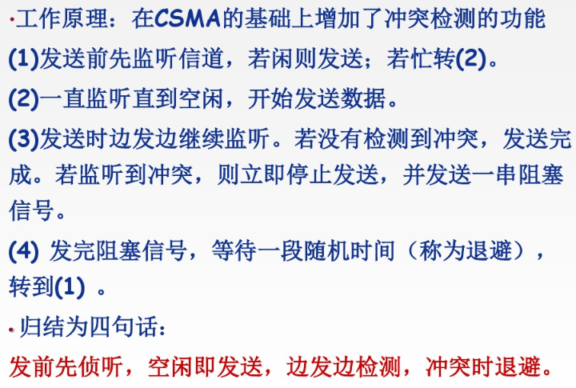
CSMA with Collision Detection (CSMA/CD)

Slide 30
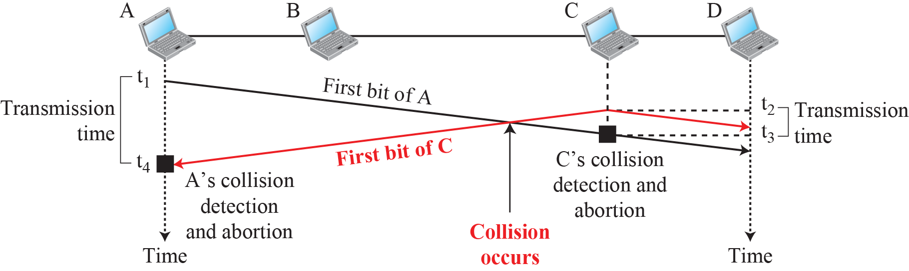
Collision of the first bit in CSMA/CD

Slide 31
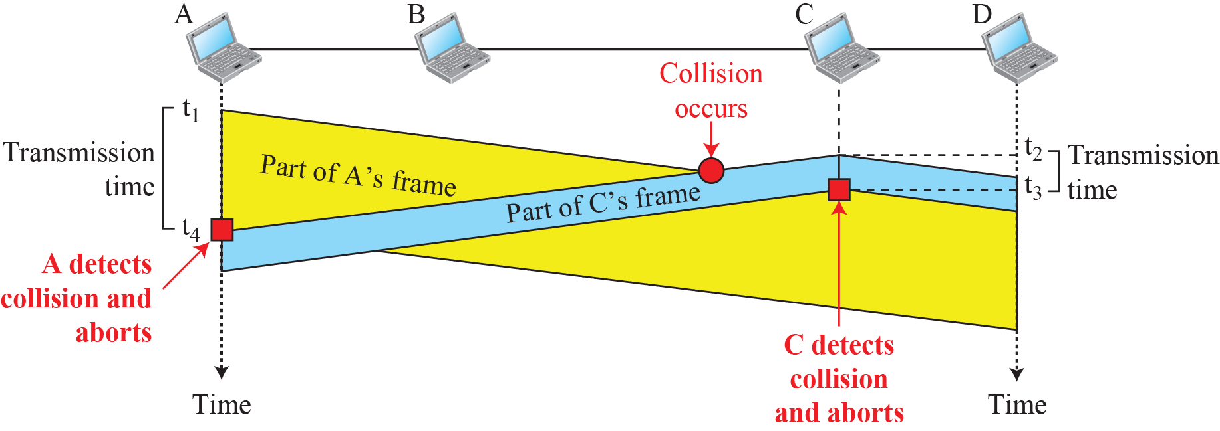
Collision and abortion in CSMA/CD

Slide 32
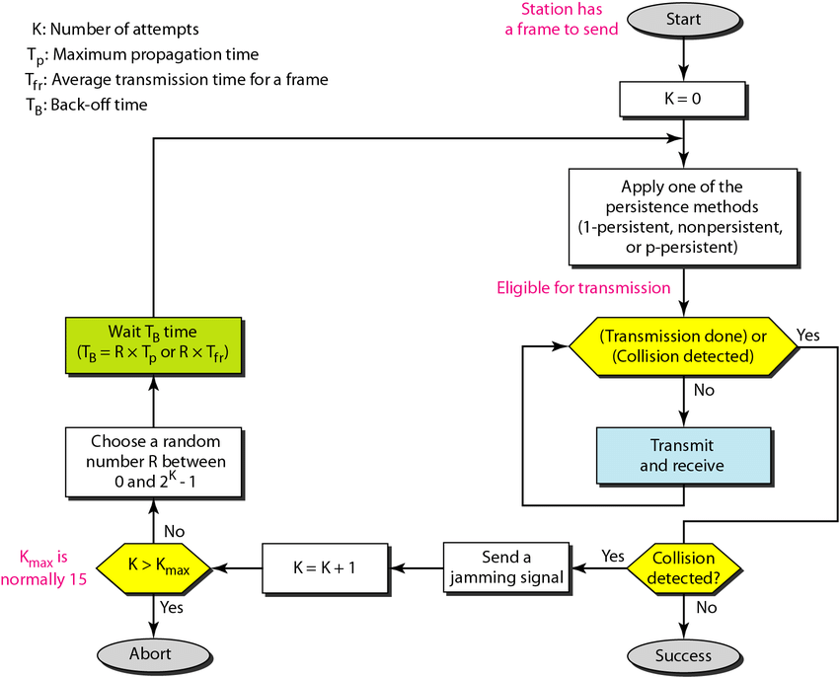
Flow diagram for CSMA/CD

Slide 33
Detecting the Collision
In CSMA / CD,
It is the responsibility of the transmitting station to detect the collision.
For detecting the collision, CSMA / CD implements the following condition.
This condition is followed by each station:
Transmission delay >= 2 * Propagation delay
According to this condition,
Each station must transmit the data packet of size whose transmission delay is at least twice its propagation delay.
If the size of data packet is smaller, then collision detection would not be possible.
Length of Data Packet,
Transmission delay = Length of data packet (L) / Bandwidth (B).
Propagation delay = Distance between the two stations (D) / Propagation speed (V)
We get L / B >= 2 * D / V.
Thus,
L >= 2 * B * D / V

Slide 34
Example
A network using CSMA/CD has a bandwidth of 10 Mbps. If the maximum propagation time (including the delays in the devices and ignoring the time needed to send a jamming signal) is T_{p} = 25.6 μs, what is the minimum size of the frame?
Solution
The minimum frame transmission time is 2 × T_{p} = 51.2 μs. This means, in the worst case, a station needs to transmit for a period of 51.2 μs to detect the collision.
The minimum size of the frame is 10 Mbps × 51.2 μs = 512 bits or 64 bytes. This is actually the minimum size of the frame for Standard Ethernet, as we will see later in the chapter.

Slide 35
Multiple Access Protocols
ALOHA »
CSMA (Carrier Sense Multiple Access) » 载波监听多路访问
Collision-free protocols » 无冲突协议
Limited-contention protocols » 有限竞争协议
Wireless LAN protocols »

Slide 36
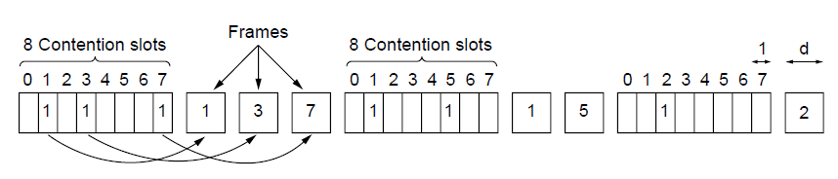
Collision-Free (1) – Bitmap
Collision-free protocols avoid collisions entirely
Senders must know when it is their turn to send
The basic bit-map protocol:
Sender set a bit in contention slot if they have data
Senders send in turn; everyone knows who has data
假设有N个站点共享信道，编号为0 ~N-1，将信道时间划分为一系列交替的竞争周期（预约周期）和数据传输周期。
一个竞争/预约周期由N个1bit的竞争时隙组成，即将竞争周期分为N个时隙，每个时隙对应一个站点。任何一个站点有数据发送时，必须在它的竞争时隙期间发送“1”进行预约。
预约周期结束后，预约过的站点按编号顺序进行发送，永不冲突。最后一个站点发完数据后，开始新一轮的预约周期。
缺点：位图协议无法考虑优先级；竞争时隙过多
仍使用离散竞争时间槽模型
Notes:
也叫reservation protocol预留协议。

Slide 37
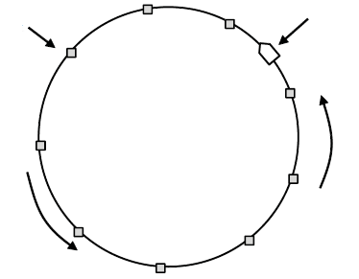
Collision-Free (2) – Token Ring
Token sent round ring defines the sending order
Station with token may send a frame before passing
Idea can be used without ring too, e.g., token bus
Token
Station
抓取到令牌的工作站可以发送一帧。
Direction of
transmission

Slide 38
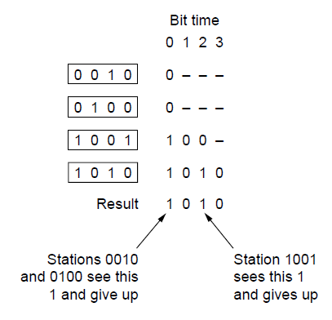
Collision-Free (3) – Binary Countdown二进制倒计数
Binary countdown improves on the bitmap protocol
Stations send their address in contention slot (log N bits instead of N bits)
Medium ORs bits; stations give up when they send a “0” but see a “1”
Station that sees its full address is next to send
基本思想
把站号按相同长度的二进制数编号，每个要发送数据的站点先广播它们的二进制地址(按高位到低位的顺序)。这些地址在信道上被按位相加(逻辑或)。
各站点在发送地址时监听信道，当发现自己地址中的某个“0”在信道上变为“1”时，即退出竞争。最后参与竞争的地址最高的站点获得发送权，即：高序号站点优先。发送结束后，重新进入下一轮竞争。
N个站的二进制编码所需位数是log₂N位

Slide 39
Multiple Access Protocols
ALOHA »
CSMA (Carrier Sense Multiple Access) » 载波监听多路访问
Collision-free protocols » 无冲突协议
Limited-contention protocols » 有限竞争协议
Wireless LAN protocols »

Slide 40
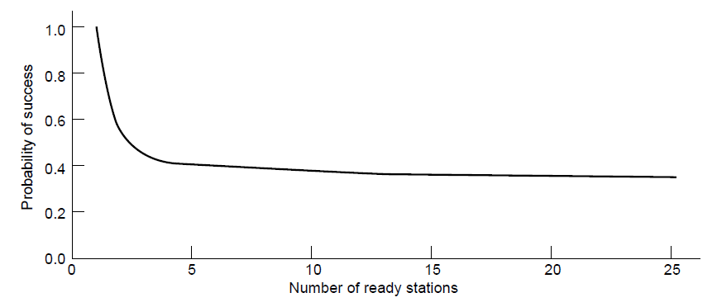
Limited-Contention Protocols (1)
Protocols those use contention at low load to provide low delay, but use collision-free technique at high load to provide good channel efficiency are called limited-contention protocols.
Idea is to divide stations into groups within which only a very small number are likely to want to send
Avoids wastage due to idle periods and collisions
Already too many contenders for a good chance of one winner

Slide 41
Limited-Contention Protocols (1)
有限竞争协议基本步骤：
将诸站点分成若干组，
在slot0，group 0的成员参加竞争，如其中之一成功，它就获得信道并传送它的帧；
若在slot0无站点发送或发生冲突，则group1的成员在slot1时参加竞争。
通过合适的分组，每个slot的竞争者就会减少，信道分配成功率就会增大，维持在该图左侧区域。
Already too many contenders for a good chance of one winner

Slide 42
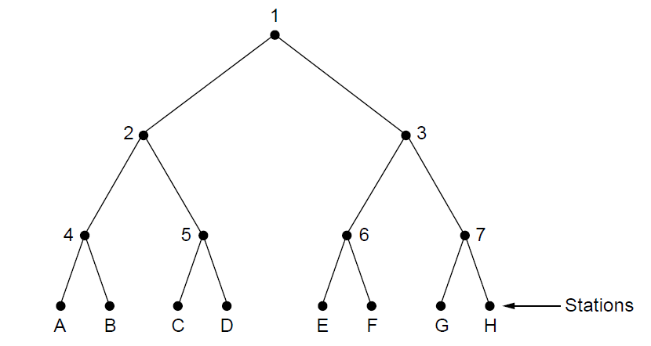
Limited Contention (2) –Adaptive Tree Walk
Tree divides stations into groups (nodes) to poll
Depth first search under nodes with poll collisions
Start search at lower levels if >1 station expected
At what level in the tree should the search begin?
Each node at level i has a fraction 2^{-i} of the stations below it.
If the number of ready stations is q and uniformly distributed, the expected number of them below a specific node at level i is just 2^{-i} q.
Intuitively, we would expect the optimal level to begin searching the tree to be the one at which the mean number of contending stations per slot is 1. i.e., 2^{-i} q = 1, we can get i =log₂q
Level 0
Level 1
Level 2

Slide 43
Adaptive Tree Walk：Example
A、G要求发送
Slot0：冲突（ level0 ，节点1下所有站）；
Slot1：level1左子树(节点2下所有站)，A成功；
Slot2：level1右子树(节点3下所有站)，G成功；
A、C要求发送
Slot0：冲突（ level0 ，节点1下所有站） ；
Slot1：冲突（leve1，节点2下所有站）；
Slot2：level2左子树（节点4下所有站），A成功；
Slot3：level2右子树（节点5下所有站），C成功；
C、D要求发送
Slot0：冲突（ level0 ，节点1下所有站）；
Slot1： level1左子树(节点2下所有站)，冲突；
slot2： level2左子树（节点4下所有站），空闲；
Slot3： level2右子树（节点5下所有站），冲突；
Slot4：左叶子节点，C成功;
Slot5：右叶子节点，D成功;
Level 0
Level 1
Level 2

Slide 44
Multiple Access Protocols
ALOHA »
CSMA (Carrier Sense Multiple Access) » 载波监听多路访问
Collision-free protocols » 无冲突协议
Limited-contention protocols » 有限竞争协议
Wireless LAN protocols »

Slide 45
Wireless LAN Protocols
Wireless has complications compared to wired.
Nodes may have different coverage regions
Leads to hidden and exposed terminals
Nodes can’t detect collisions, i.e., sense while sending
Makes collisions expensive and to be avoided

Slide 46
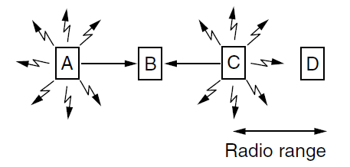
Hidden terminals
Hidden terminals are senders that cannot sense each other but nonetheless collide at intended receiver
Want to prevent; loss of efficiency
A and C are hidden terminals when sending to B

Slide 47
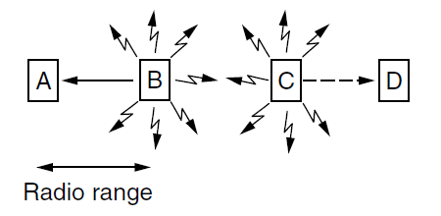
Exposed terminals
Exposed terminals are senders who can sense each other but still transmit safely (to different receivers)
Desirably concurrency; improves performance
B → A and C → D are exposed terminals

Slide 48
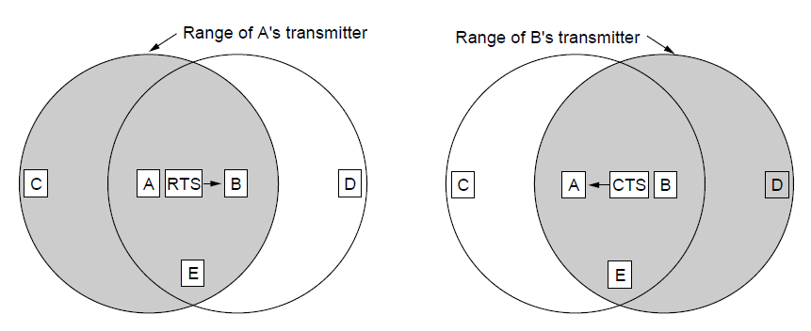
MACA：Multiple Access with Collision Avoidance
MACA protocol grants access for A to send to B:
A sends RTS(Request to Send) to B [left]; B replies with CTS (Clear to Send) [right]
A can send with exposed but no hidden terminals
【基本思想】
发送站点刺激接收站点发送应答短帧，从而使得接收站点周围的站点监听到该帧，并在一定时间内避免发送数据。
而非采用载道监听机制。
【基本过程】
如图，A向B发送RTS（Request To Send）帧，A周围的站点在一定时间内不发送数据，以保证CTS帧返回给A；
B向A回答CTS（Clear To Send）帧，B周围的站点在一定时间内不发送数据，以保证A发送完数据；
A开始发送 –若发生冲突(两站点同时发送RTS)，则等待随机时间，再重试。
A sends RTS to B;
C and E hear and defer for CTS
B replies with CTS;
D and E hear and defer for data

Slide 49
Chapter 4：Medium Access Control Sublayer
Channel Allocation Problem
Multiple Access Protocols
Ethernet
Wireless LANs
Broadband Wireless
Bluetooth
RFID
Data Link Layer Switching

Slide 50
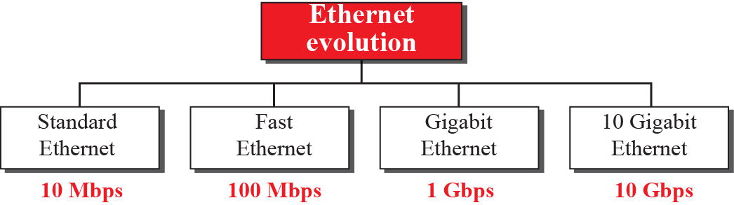
Ethernet
Classic Ethernet »
Switched/Fast Ethernet »
Gigabit/10 Gigabit Ethernet »
802.3
802.3u
802.3z
802.3ae

Slide 51
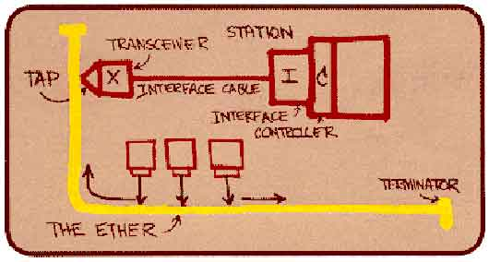
Ethernet
“Dominant” LAN technology developed in the 1970s by Robert Metcalfe and David Boggs.
First widely used LAN technology
Simpler, cheaper than token LANs and ATM
Kept up with speed race: 10, 100, 1000 Mbps 10Gbps, …
Metcalfe’s Ethernet
sketch

Slide 52
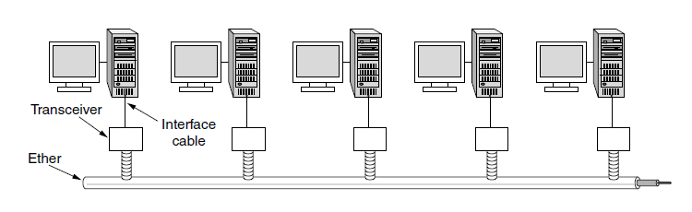
Classic Ethernet – Physical Layer
One shared coaxial cable to which all hosts attached
Up to 10 Mbps, with Manchester encoding
Hosts ran the classic Ethernet protocol for access

Slide 53
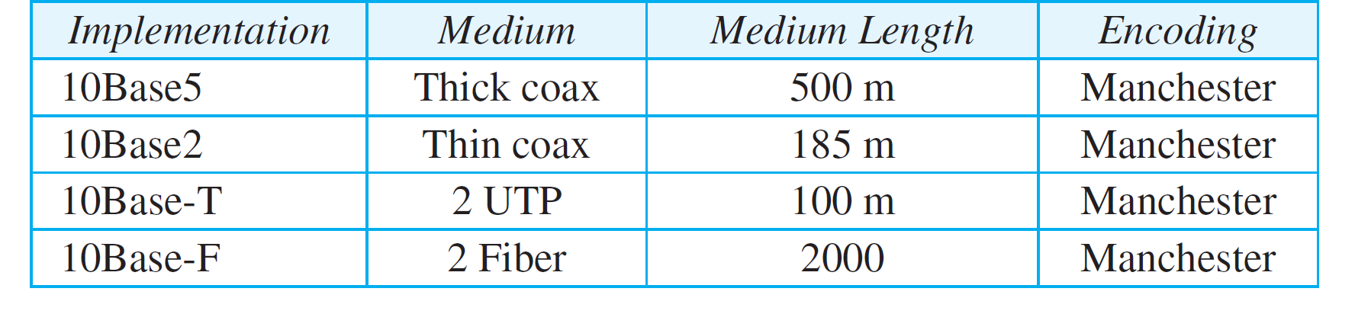
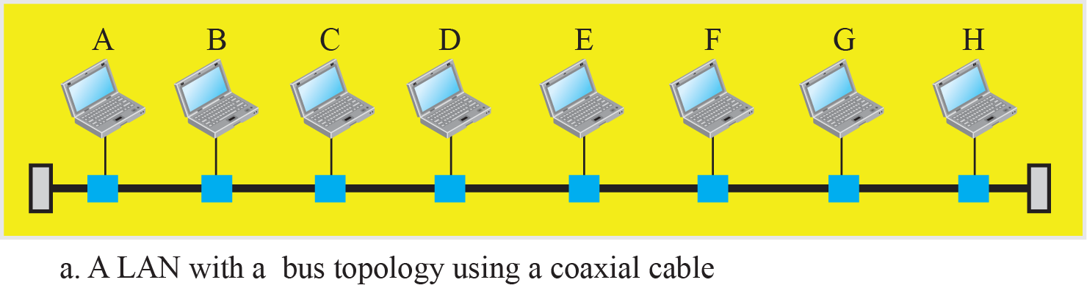
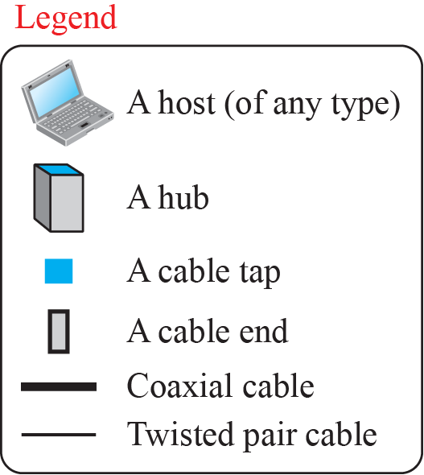
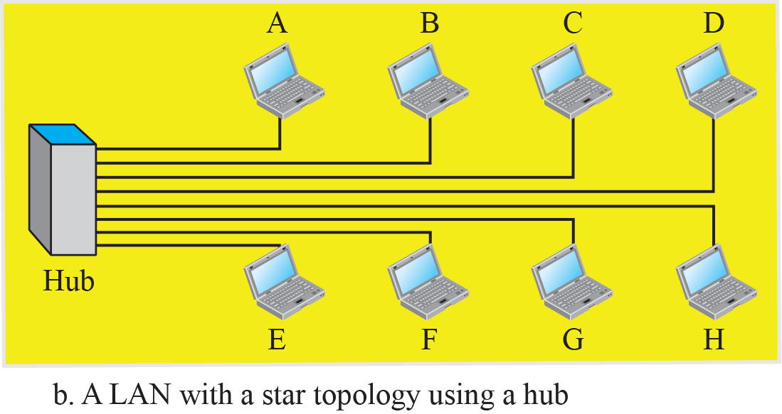
Classic Ethernet – Implementation

Slide 54
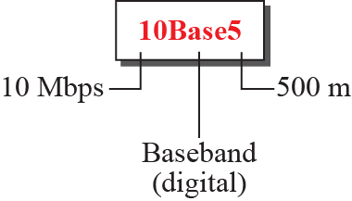
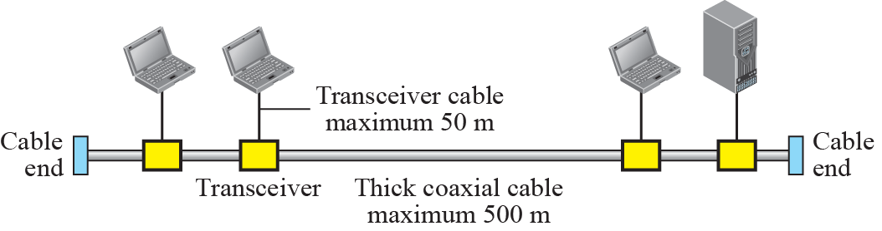
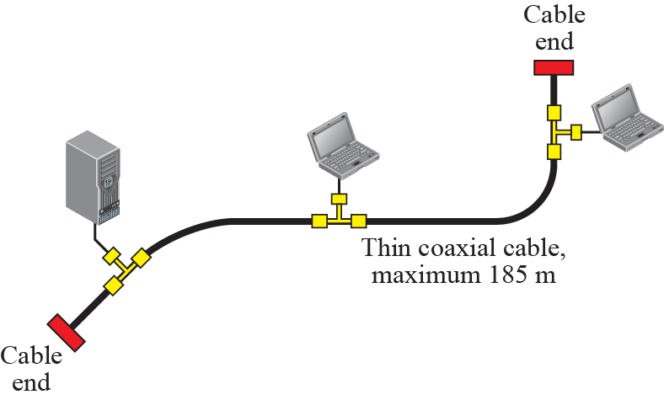
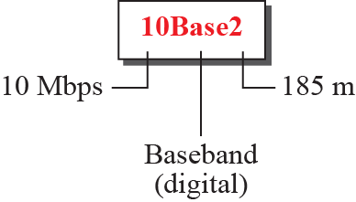
Classic Ethernet – 10Base5 and 10Base2

Slide 55
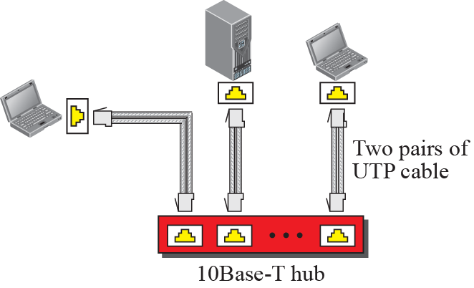
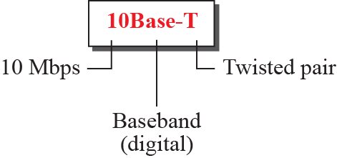
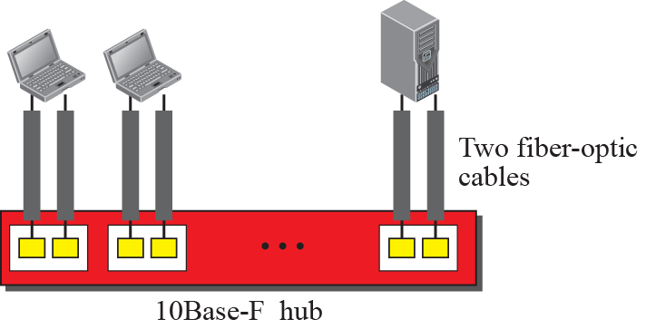
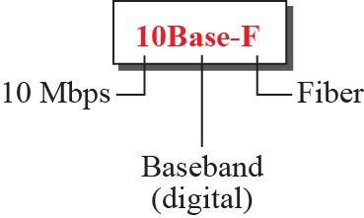
Classic Ethernet – 10BaseT and 10BaseF

Slide 56
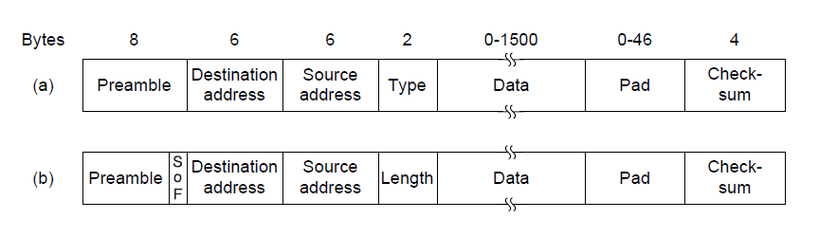
Classic Ethernet – MAC and Frame
MAC protocol is 1-persistent CSMA/CD (earlier)
Random delay (backoff) after collision is computed with BEB (Binary Exponential Backoff)
Frame format is still used with modern Ethernet.
Ethernet
(DIX)
IEEE 802.3

Slide 57
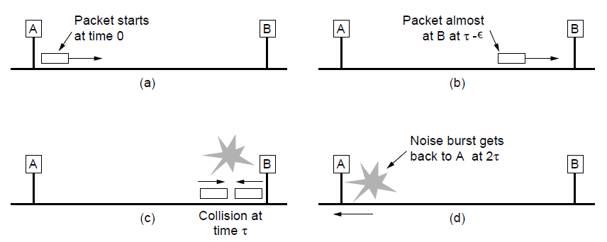
Classic Ethernet – CSMA/CD
Collisions can occur and take as long as 2τ to detect
τ is the time it takes to propagate over the Ethernet
Leads to minimum packet size for reliable detection

Slide 58
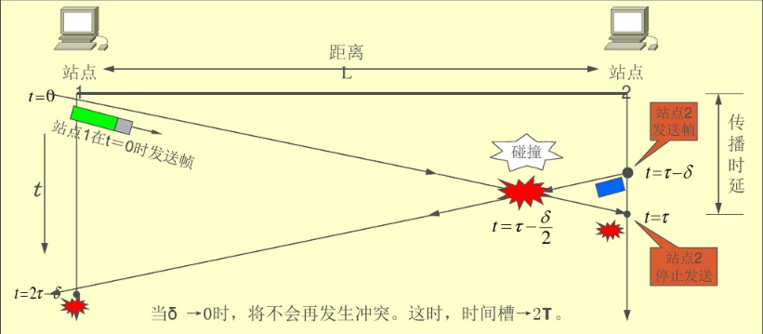
CSMA/CD Time Slot---能够检测到冲突的时间区间(或称为争用时隙或碰撞窗口)
若两站点之间传播时延为τ，则Time Slot = 2τ

Slide 59
Significance of Time Slot
时间槽的意义
一个站点开始发送后，若在时间槽内没有检测到冲突，则本次发送不会再发生冲突；
时间槽与网络跨距、传播速率有密切关系！
IEEE802.3将时间槽取为发送512位的时间，称为512位时。
以太网中，传输速率=10Mbps时，时间槽=51.2us；一个时间槽内可以发送512bits，即64字节（所以也称一个时间槽长度为64字节）
由此可知：
冲突只可能在一帧的前64个字节内发生；
帧长度小于64字节时，将无法检测出冲突；
所以，以太网规定，最小帧长度为64字节。
长度小于64字节的帧（碎片帧，冲突碎片）都是无效帧。

Slide 60
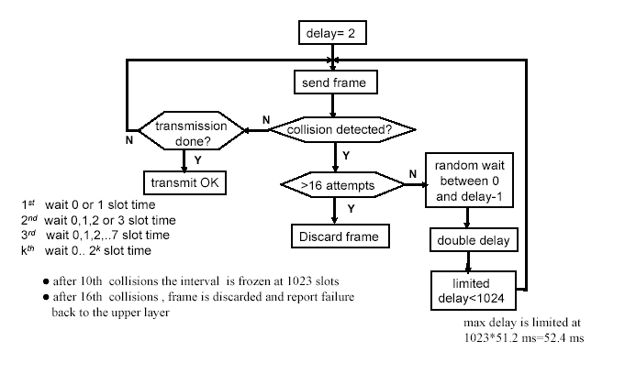
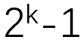

Classic Ethernet – CSMA/CD with BEB (Binary Exponential Backoff)
前10次冲突：每次冲突后，可选时间槽数量每次加倍；
后五次冲突：可选时间片数量不变（2^{k}-1=1023个slots）。
所以，也称为截断式（Truncated）二进制指数退避算法。
其中，时间槽2τ的长度为512bit的时间，10Mbps的以太网为51.2us。

Slide 61
Example
A network using CSMA/CD has a bandwidth of 10 Mbps. If the maximum propagation time (including the delays in the devices and ignoring the time needed to send a jamming signal) is T_{p} = 25.6 μs, what is the minimum size of the frame?
Solution
The minimum frame transmission time is 2 × T_{p} = 51.2 μs. This means, in the worst case, a station needs to transmit for a period of 51.2 μs to detect the collision.
The minimum size of the frame is 10 Mbps × 51.2 μs = 512 bits or 64 bytes. This is actually the minimum size of the frame for Standard Ethernet, as we will see later in the chapter.

Slide 62
Classic Ethernet – Addressing
Each station on an Ethernet network (such as a PC, workstation, or printer) has its own network interface card (NIC).
The NIC fits inside the station and provides the station with a link-layer address.
The Ethernet address is 6 bytes (48 bits), normally written in hexadecimal notation, with a colon between the bytes.
For example, the following shows an Ethernet MAC address:
4A:30:10:21:10:1A
You can use “ipconfig /all” to check the MAC addresses of your PC or laptop.

Slide 63
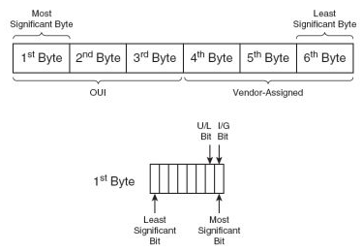
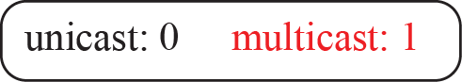


Classic Ethernet – unicast and multicast address
To find the type of the address, the IEEE has specified that the most significant bit of the most significant byte be used for this purpose.
If it is 0, the address is unicast.
If it is 1, the address is multicast.
If all digits are Fs, the address is broadcast.
The most significant byte is the left most byte in the address, and the most significant bit is the right most bit of the byte.

Slide 64
Example
Define the type of the following destination addresses:
4A:30:10:21:10:1A (A对应的二进制1010)
47:20:1B:2E:08:EE (7对应的二进制0111)
FF:FF:FF:FF:FF:FF (对应二进制：全1)
Solution
a. This is a unicast address because A in binary is 1010 (even).
b. This is a multicast address because 7 in binary is 0111 (odd).
c. This is a broadcast address because all digits are Fs in
hexadecimal.

Slide 65

Classic Ethernet – Performance
Efficient for large frames, even with many senders
Degrades for small frames (and long LANs)
10 Mbps Ethernet,
64 byte min. frame

Slide 66


Classic Ethernet – Bandwidth sharing

Slide 67


Collision domains
A bridge is the separation of the collision domain

Slide 68


Full-duplex Switched Ethernet

Slide 69

Switched/Fast Ethernet (1)
Hubs wire all lines into a single CSMA/CD domain
Switches isolate each port to a separate domain
Much greater throughput for multiple ports
No need for CSMA/CD with full-duplex lines
Notes:
、

Slide 70

Switched/Fast Ethernet (2)
Switches can be wired to computers, hubs and switches
Hubs concentrate traffic from computers
More on how to switch frames the in chapter 4.8
A switch improves performance over a hub in two ways
First, since there are no collisions, the capacity is used more efficiently.
Second, and more importantly, with a switch multiple frames can be sent simultaneously (by different stations).
Switch
Hub
Switch ports
Twisted pair

Slide 71

Switched/Fast Ethernet (3)
Fast Ethernet extended Ethernet from 10 to 100 Mbps
The MAC sublayer was left unchanged.
To keep the minimum size of the frame, the maximum length of the network should be 10 times shorter
Twisted pair (with Cat 5) dominated the market
Transmission delay >= 2 * Propagation delay
L >= 2 * B * D / V
快速以太网制定了三种有关传输介质的标准：100BASE-T4，100BASE-TX、100BASE-FX。后两种支持全双工模式。
100 BASE-T下有X或4两个标准：（1）TX表示传输介质2对5类UTP高质量的双绞线，一对用于发送数据，一对用于接受数据，全双工工作；（2）T4使用的是4对3类非屏蔽（UTP)双绞线

Slide 72
Fast Ethernet (4)
IEEE 802.3u工作组规范（1995,6）
特点：
传输率比普通以太网快10倍（达到100Mbps）
采用CSMA/CD控制方式和802.3帧格式
100Base-TX采用2对5类双绞线
100Base-T4采用4对3类双绞线

Slide 73
交换机的工作原理及交换方式
交换机的交换方式
（1）直接交换方式
交换机只接收数据帧头部，检测目的地址，立即转发（无论帧是否出错）
帧出错检测由结点主机完成（延迟小，缺乏差错检测）
（2）存储转发交换方式
交换机完整地接收数据帧，并检测差错。若帧正确，则根据帧目的地址确定输出端口，进行转发出
具有帧差错检测能力，延迟大
（3）改进的直接交换方式（二者结合）
在接收到数据的前64字节之后,判断数据的头部字段是否正确,如果正确则转发出去,这种方法对于短数据来说,交换延迟与直接交换方式比较接近;而对于长数据来说 ,由于它只对数据前部的主要字段进行差错检测,因此交换延迟将会明显减少
局域网交换机结构与工作原理

Slide 74



Encoding for fast Ethernet
100BASE-TX使用的2对5类非屏蔽双绞线，最大传输距离是100米。其中一对用于发送数据，另一对用于接收数据。
100Base-FX使用的是两股光纤，其中一股用于发送数据，另一股用于接收数据。
100：表示传输速率为100Mbps；
Base：表示采用基带传输；
T：表示传输介质为双绞线，当为F时，代表为光纤；
100BASE-T4使用的是4对3类非屏蔽（UTP)双绞线，最大传送距离是100米。

Slide 75

Gigabit / 10 Gigabit Ethernet
Switched Gigabit Ethernet is now the garden variety
With full-duplex lines between computers/switches

Slide 76
Gigabit / 10 Gigabit Ethernet – operation mode
IEEE 802.3z(1998) and 802.3ab(1999.6)工作组规范
The address length, the frame format, and the maximum and minimum frame length are kept the same.
To achieve a data rate of 1 Gbps, this was no longer possible to keep the MAC sublayer untouched.
Gigabit Ethernet has two distinctive approaches for medium access:
half-duplex: used with a hub. CSMA/CD required. The maximum distance is 100 times less than that in classic Ethernet (2500m→25m).
full-duplex: “normal” mode. Used in central switch. buffered. No contention, no CSMA/CD

Slide 77
Gigabit / 10 Gigabit Ethernet – network radius
Two features to the standard to increase the radius:
Carrier extension: tells the hardware to add its own padding after the normal frame(64 bytes) to extend the frame to 512 bytes.
Frame bursting: allows a sender to transmit a concatenated sequence of multiple frames in a single transmission.
These two features extend the radius of the network to 200 meters.
最小帧长512字节
网络最大距离：200m。

Slide 78


Gigabit / 10 Gigabit Ethernet – implementation
Gigabit Ethernet is commonly run over twisted pair
10 Gigabit Ethernet is being deployed where needed
40/100 Gigabit Ethernet is under development
SR表示短距离,
LR表示长距离,
ER 表示超长距离

Slide 79


Encoding in Gigabit Ethernet

Slide 80
Chapter 4：Medium Access Control Sublayer
Channel Allocation Problem
Multiple Access Protocols
Ethernet
Wireless LANs
Broadband Wireless
Bluetooth
RFID
Data Link Layer Switching

Slide 81
Wireless LANs
802.11 architecture/protocol stack »
802.11 physical layer »
802.11 MAC »
802.11 frames »

Slide 82

802.11 Architecture/Protocol Stack (1)
Wireless clients associate to a wired AP (Access Point)
Called infrastructure mode; there is also ad-hoc mode with no AP, but that is rare.
To Network
Access Point
Client

Slide 83

802.11 Architecture/Protocol Stack (2)
MAC is used across different physical layers
逻辑链路控制层子层：隐藏802系列协议的差异，使它们在网络层看起来无差别
介质访问子层：决定如何分配信道

Slide 84



Basic Service Set & Extended Service Set

Slide 85
802.11 physical layer
NICs are compatible with multiple physical layers
E.g., 802.11 a/b/g
Name | Technique | Max. Bit Rate
802.11b | Spread spectrum, 2.4 GHz | 11 Mbps
802.11g | OFDM, 2.4 GHz | 54 Mbps
802.11a | OFDM, 5 GHz | 54 Mbps
802.11n | OFDM with MIMO, 2.4/5 GHz | 600 Mbps
Wi-Fi采用该标准802.11b

Slide 86

Flow Diagram for CSMA/CA
CSMA/CD主要适用以太网。 CSMA/CA主要适用无线局域网。
CSMA/CA与CSMA/CD的不同：
在CSMA/CD中，节点侦听到信道空闲时立即发送；而在CSMA/CA中，节点要推迟发送，每新尝试一次都要随机回退。这是为了避免有多个站同时等待信道空闲，并发现信道空闲后立即发送而造成的冲突。
帧间间隔（IFS: interframe space）：为了尽量避免碰撞，802.11规定，所有的站在完成发送后，必须再等待一段很短的时间（继续监听）才能发送下一帧。这段时间的通称是帧间间隔IFS。
帧间间隔的长短取决于该站要发送的帧的类型。高优先级的帧需要等待的时间较短，因此可以优先获得发送权，但低优先级帧就必须等待较长的时间。

Slide 87

802.11 MAC (1)
CSMA/CA inserts backoff slots to avoid collisions
MAC uses ACKs/retransmissions for wireless errors

Slide 88

802.11 MAC (2)
Virtual channel sensing with the NAV（Network Allocation Vector) and optional RTS/CTS (often not used) avoids hidden terminals

Slide 89

802.11 MAC (3)
为了尽量避免碰撞，802.11规定，所有的站在完成发送后，必须再等待一段很短的时间（继续监听）才能发送下一帧。这段时间的通称是帧间间隔IFS。帧间间隔的长短取决于该站要发送的帧的类型。高优先级的帧需要等待的时间较短，因此可以优先获得发送权，但低优先级帧就必须等待较长的时间。
SIFS：短帧间间隔，用来间隔需要立即响应的帧，如控制帧(RTS/CTS/ACK)等
AIFS：任意帧间间隔。根据访问类别(即要传输的数据类型)对站点进行优先级排序，AISF的计算公式为：AISF编号*时隙+ SISF；
DIFS：分布协调功能帧间间隔，只能够由工作于DCF模式的站点来使用
PIFS：集中协调功能帧间间隔，只能够由工作于PCF模式的站点来使用
EIFS: 在前一帧出错的情况下，发送节点 不得不延迟 EIFS 而不是DIFS时间段，再发送下一帧。
Different backoff slot times add quality of service
Short intervals give preferred access, e.g., control, VoIP
MAC has other mechanisms too, e.g., power save

Slide 90


802.11 Frames
Frames vary depending on their type (Frame control)
802.11协议帧有三种类型：Management Frame(如Authentication、De-authentication、Probe Req、Probe Response等)、Control Frames(如RTS、CTS、ACK等)、Data Frames。可以通过Frame Control字段的Type字节来确定帧的类型。
Data frames have 3 addresses (at most 4 addresses) to pass via Aps
目的Addr， 源Addr，BSS ID
Frame Control占用 2 bytes
version占用2bit,代表协议编号，目前一直是0；
Type占2bit，如上表；
Subtype占4bit，进一步判断帧的子类型
Duration表明该帧和它的确认帧将会占用信道多长时间，Duration 值用于网络分配向量(NAV)计算
Sequence Control(序列控制域): 用于过滤重复帧
Notes:
参考：https://blog.csdn.net/weixin_35771144/article/details/105782182

Slide 91

Subfields in Frame Control field
Type | 帧类型
00 | 管理帧
01 | 数据帧
10 | 控制帧
11 | 保留

Slide 92





Addressing Mechanism
Data Frame具有方向，这个方向用DS（分布式系统）字段来标识，以区分不同类型帧中关于地址的解析方式；其它的类型Frame例如Control Frame或者管理帧中，这个字段是全零。这个字段用两位表示，这两个位的含义分别表示“To Ds”和“From Ds”，大致含义如下：
To DS：表示Station->AP，一般也叫Upload。
From DS：表示AP->Station，一般也叫Download。
DS虽然大致等于AP但是它不是AP，它其实是一个系统，从Station的角度来看，比较容易理解。并且To DS和From DS一定是无线网络上的数据帧才有的字段。

Slide 93
Chapter 4：Medium Access Control Sublayer
Channel Allocation Problem
Multiple Access Protocols
Ethernet
Wireless LANs
Broadband Wireless
Bluetooth
RFID
Data Link Layer Switching

Slide 94
Broadband Wireless
802.16 Architecture / Protocol Stack »
802.16 Physical Layer »
802.16 MAC »
802.16 Frames »

Slide 95

802.16 Architecture/Protocol Stack (1)
Wireless clients connect to a wired basestation (like 3G)
The 802.16 architecture

Slide 96

802.16 Architecture/Protocol Stack (2)
MAC is connection-oriented; IP is connectionless
Convergence sublayer maps between the two

Slide 97

802.16 Physical Layer
Based on OFDM; base station gives mobiles bursts (subcarrier/time frame slots) for uplink and downlink

Slide 98
802.16 MAC
Connection-oriented with base station in control
Clients request the bandwidth they need
Different kinds of service can be requested:
Constant bit rate, e.g., uncompressed voice
Real-time variable bit rate, e.g., video, Web
Non-real-time variable bit rate, e.g., file download
Best-effort for everything else

Slide 99

802.16 Frames
Frames vary depending on their type
Connection ID instead of source/dest addresses
(a)
(b)
(a) A generic frame. (b) A bandwidth request frame

Slide 100
Bluetooth
Bluetooth Architecture »
Bluetooth Applications / Protocol »
Bluetooth Radio / Link Layers »
Bluetooth Frames »

Slide 101

Bluetooth Architecture
Piconet master is connected to slave wireless devices
Slaves may be asleep (parked) to save power
Two piconets can be bridged into a scatternet

Slide 102

Bluetooth Applications / Protocol Stack
Profiles give the set of protocols for a given application
25 profiles, including headset, intercom(内部通话系统，类似对讲机), streaming audio, remote control, personal area network, …
L2CAP（Logical Link Control and Adaptation Protocol）：主要负责通道的多路复用、上层应用数据的分割/重组、生成PDU、基于L2CAP channel的流控机制等。

Slide 103
Bluetooth Radio / Link Layers
Radio layer
The radio layer moves the bits from master to slave, or vice versa.
Uses adaptive frequency hopping in 2.4 GHz ISM band
Link layer
It turns the raw bit stream into frames and defines some key formats.
TDM with timeslots for master and slaves
The link manager protocol sets up logical channels, called links, to carry frames between the master and a slave device that have discovered each other. Two main kinds of links: SCO and ACL.
Synchronous Connection Oriented(SCO) link for periodic slots in each direction
Asynchronous ConnectionLess(ACL) link for packet-switched data at irregular intervals, delivered on a best-effort basis.
Links undergo pairing (user confirms passkey/PIN) to authorize them before use

Slide 104

Bluetooth Frames
Time is slotted; enhanced data rates send faster but for the same time; addresses are only 3 bits for 8 devices
(a)
(b)
(a)
(b)

Slide 105


Bluetooth VS NearLink
Notes:
SLE (Super Low Energy) 模式旨在将功耗降到极低，以延长电池供电设备的使用寿命。该模式通过减少设备的活动时间和降低数据传输速率来实现最低功耗。
SLB (Super Low Bandwidth)模式旨在极大降低数据传输带宽，以适应那些带宽要求低但对功耗和稳定性要求高的场景。
该标准于 2022 年 11 月发布了 1.0 版本，并于 2023 年 4 月发布了1.1 版本。 2023 年 8 月 4 日，华为在第五届华为开发者大会上，正式发布新一代近距离无线连接技术——星闪(NearLink)；9 月8日，华为 Mate60 Pro+上线，星闪首次入驻华为 Mate60手机。 从正式启动标准化工作到正式商用，星闪仅仅用了两年多的时间，为史上发展最快的近距离无线联接技术。

Slide 106
RFID (Radio Frequency Identification)
Gen 2 Architecture »
Gen 2 Physical Layer »
Gen 2 Tag Identification Layer »
Gen 2 Frames »

Slide 107

Gen 2 Architecture
Reader signal powers tags; tags reply with backscatter

Slide 108

Gen 2 Physical Layer
Reader uses duration of on period to send 0/1
Tag backscatters reader signal in pulses to send 0/1
The reader uses two amplitude levels. Bits are determined to be either a 0 or a 1, depending on how long the reader waits before a low-power period.
The tag measures the time between low-power periods and compares this time to a reference measured during a preamble. As shown in Fig., 1s are longer than 0s.

Slide 109

Gen 2 Tag Identification Layer
Reader sends query and sets slot structure
Tags reply (RN16) in a random slot; may collide
Reader asks one tag for its identifier (ACK)
Process continues until no tags are left
EPC (Electronic Product Code)

Slide 110

Gen 2 Frames
Reader frames vary depending on type (Command)
Query shown below, has parameters and error detection
Tag responses are simply data
Reader sets timing and knows the expected format
1000表示是个Query message
Query message
Notes:
The next flags, DR, M, and TR, determine the physical layer parameters for reader transmissions and tag responses.
Then come three fields, Sel, Session, and Target, that select the tags to respond.
Q：this field defines the range of slots over which tags will respond, from 0 to 2^{Q}−1.
Finally, there is a CRC to protect the message fields.

Slide 111
Chapter 4：Medium Access Control Sublayer
Channel Allocation Problem
Multiple Access Protocols
Ethernet
Wireless LANs
Broadband Wireless
Bluetooth
RFID
Data Link Layer Switching

Slide 112
Data Link Layer Switching
Uses of Bridges »
Learning Bridges »
Spanning Tree »
Repeaters, hubs, bridges, .., routers, gateways »
Virtual LANs »

Slide 113

Uses of Bridges
Common setup is a building with centralized wiring
Bridges (switches) are placed in or near wiring closets

Slide 114

Learning Bridges (1)
A bridge operates as a switched LAN (not a hub)
Computers, bridges, and hubs connect to its ports

Slide 115
Learning Bridges (2)
Backward learning algorithm picks the output port:
Associates source address on frame with input port
Frame with destination address sent to learned port
Unlearned destinations are sent to all other ports
Needs no configuration
Forget unused addresses to allow changes
Bandwidth efficient for two-way traffic

Slide 116

Learning Bridges (3)
Bridges extend the Link layer:
Use but don’t remove Ethernet header/addresses
Do not inspect Network header

Slide 117

Spanning Tree (1) – Problem
Bridge topologies with loops and only backward learning will cause frames to circulate for ever
Need spanning tree support to solve problem

Slide 118
Spanning Tree (2) – Algorithm
I think that I shall never see
A graph more lovely than a tree.
A tree whose crucial property
Is loop-free connectivity.
A tree which must be sure to span.
So packets can reach every LAN.
First the Root must be selected
By ID it is elected.
Least cost paths from Root are traced
In the tree these paths are placed.
A mesh is made by folks like me
Then bridges find a spanning tree.
– Radia Perlman, 1985.
Subset of forwarding ports for data is use to avoid loops
Selected with the spanning tree distributed algorithm by Perlman

Slide 119

Spanning Tree (3) – Example
After the algorithm runs:
B1 is the root, two dashed links are turned off
B4 uses link to B2 (ID lower than B3 also at distance 1)
B5 uses B3 (distance 1 versus B4 at distance 2)

Slide 120

Repeaters, Hubs, Bridges, Switches, Routers, & Gateways
Devices are named according to the layer they process
A bridge or LAN switch operates in the Link layer

Slide 121


Virtual LANs (1)
VLANs (Virtual LANs) splits one physical LAN into multiple logical LANs to ease management tasks
Ports are “colored” according to their VLAN

Slide 122

Virtual LANs (2) – IEEE 802.1Q
Bridges need to be aware of VLANs to support them
In 802.1Q, frames are tagged with their “color”
Legacy switches with no tags are supported

Slide 123


Virtual LANs (3) – IEEE 802.1Q
802.1Q frames carry a color tag (VLAN identifier)
Length/Type value is 0x8100 for VLAN protocol

Slide 124
End
Chapter 4
Computer Networks, Chapter 4 Medium Access Control Sublayer

Slide 125
Q & A

